Slide 1
Accessing Array Contents
ELEC1006: ENGINEERING COMPUTING

Slide 2

Accessing Array Contents
Can access element with a constant or literal subscript:
cout << tests[3] << endl;
Can use integer expression as subscript:
int i = 5;
cout << tests[i] << endl;
PAGE 2

Slide 3
Using a Loop to Step Through an Array
Example – The following code defines an array, numbers, and assigns 99 to each element:
const int ARRAY_SIZE = 5;
int numbers[ARRAY_SIZE];
for (int count = 0; count < ARRAY_SIZE; count++)
numbers[count] = 99;
PAGE 3

Slide 4
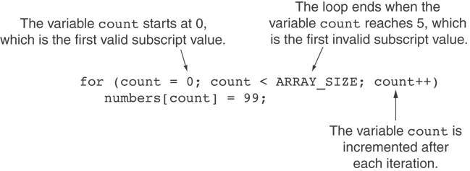
A Closer Look at the Loop
PAGE 4

Slide 5
Default Initialisation
Global array → all elements initialized to 0 by default
Local array → all elements uninitialized by default
PAGE 5

Slide 6
No Bounds Checking in C++
When you use a value as an array subscript, C++ does not check it to make sure it is a valid subscript.
In other words, you can use subscripts that are beyond the bounds of the array.
PAGE 6

Slide 7
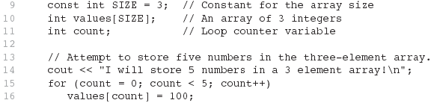
Example 2
The following code defines a three-element array, and then writes five values to it!
PAGE 7

Slide 8
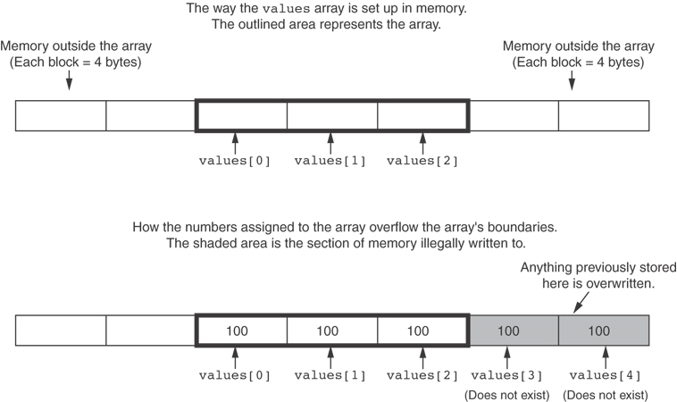
Example 2 (continued)
PAGE 8

Slide 9
No Bounds Checking in C++
Be careful not to use invalid subscripts.
Doing so can corrupt other memory locations, crash program, or lock up computer, and cause elusive bugs.
PAGE 9

Slide 10
Off-by-One Errors
An off-by-one error happens when you use array subscripts that are off by one.
This can happen when you start subscripts at 1 rather than 0:
// This code has an off-by-one error.
const int SIZE = 100;
int numbers[SIZE];
for (int count = 1; count <= SIZE; count++)
numbers[count] = 0;
PAGE 10

Slide 11
More info
[1] cplusplus.com: Arrays
https://www.cplusplus.com/doc/tutorial/arrays/
[2] learncpp.com: 6.3 – Arrays and loops
https://www.learncpp.com/cpp-tutorial/63-arrays-and- loops/
PAGE 11

